Slide 1
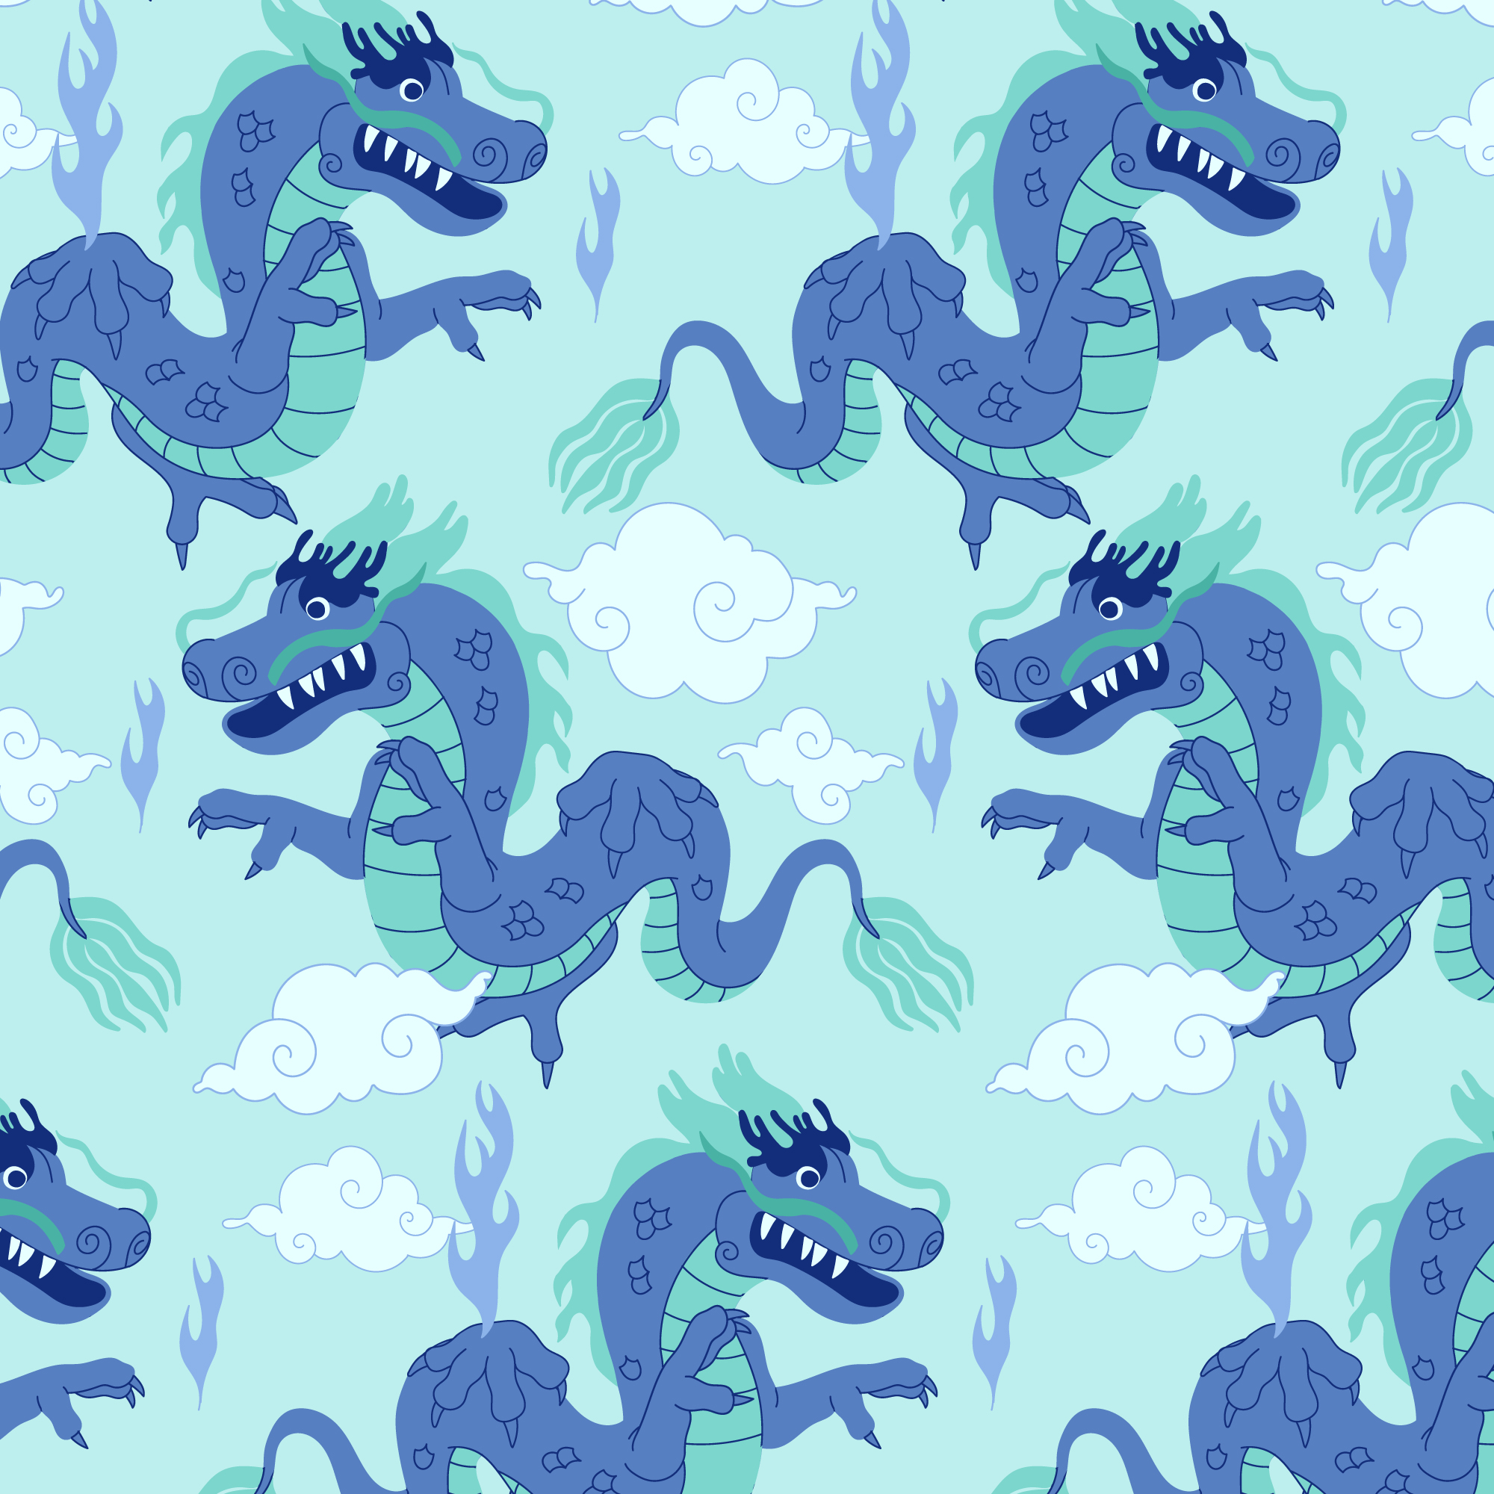

Rallye lecture - Dragons
 | 1 | 2 | 3 | 4 | 5 | 6 | 7 | 8 | 9 | 1o
ANAS
DARIA
ELWAN
FARESS
HAFSA
JAËL
JOLAYBIB
KAÏA
KELYNA
MAKEDA
MIRANDA
RAYAN
WASSIM
YASHWIN
YASMINE

